Slide 1
29 – Clean Code – State Machine Compiler (SMC)
Based on the CleanCoders videos by Uncle Bob Martin
Rupert Waldron

Slide 2
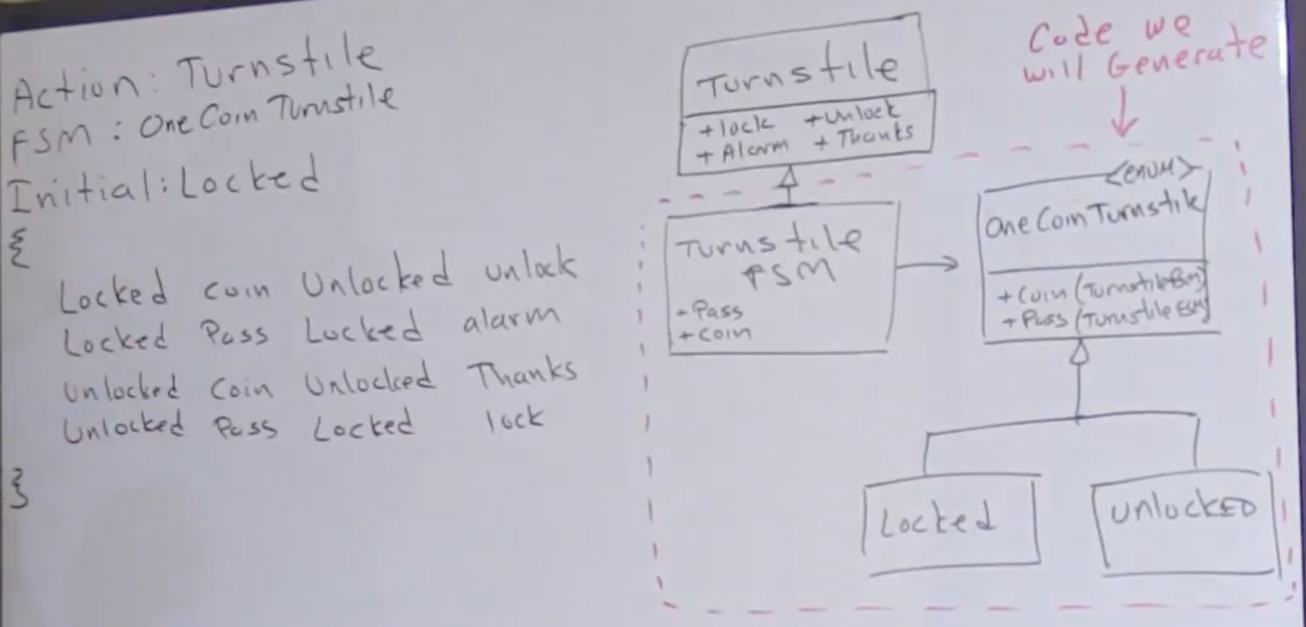
State Machine Compiler (SMC) - Parser
Here we aim to generate our state machine for the turnstile from our state table

Slide 3
State Machine Compiler (SMC) - Parser
Now we have the specification, we can create a formal spec using Backus-Naur Form – BNF.

Slide 4
Backus–Naur form (BNF)
Backus-Naur form is a metasyntax often used to describe the syntax of languages
//OneCoin
Actions: Turnstile
FSM: OneCoinTurnstile
Initial: Locked
{
Locked {
Coin Unlocked {alarmOff unlock}
Pass Locked alarmOn
}
Unlocked {
Coin Unlocked thankyou
Unlocked Pass Locked lock
}
}
FSM::=<Header>*<Logic>
<Header> ::= <Name> “:” <Name>
<Logic> ::= “{“ <Transition>* “}”
<Transition> ::= <State> “{“ <State-Spec> “}”
<State> ::= <Name>
<State-Spec> ::= <Event> ” ” <State> ” ” <Action>
<Event> ::= <Name>
<Action> ::= <Name> | “{“ <Name> “ ” <Action> “}”
<Name> ::= \w+
Headers

Slide 5
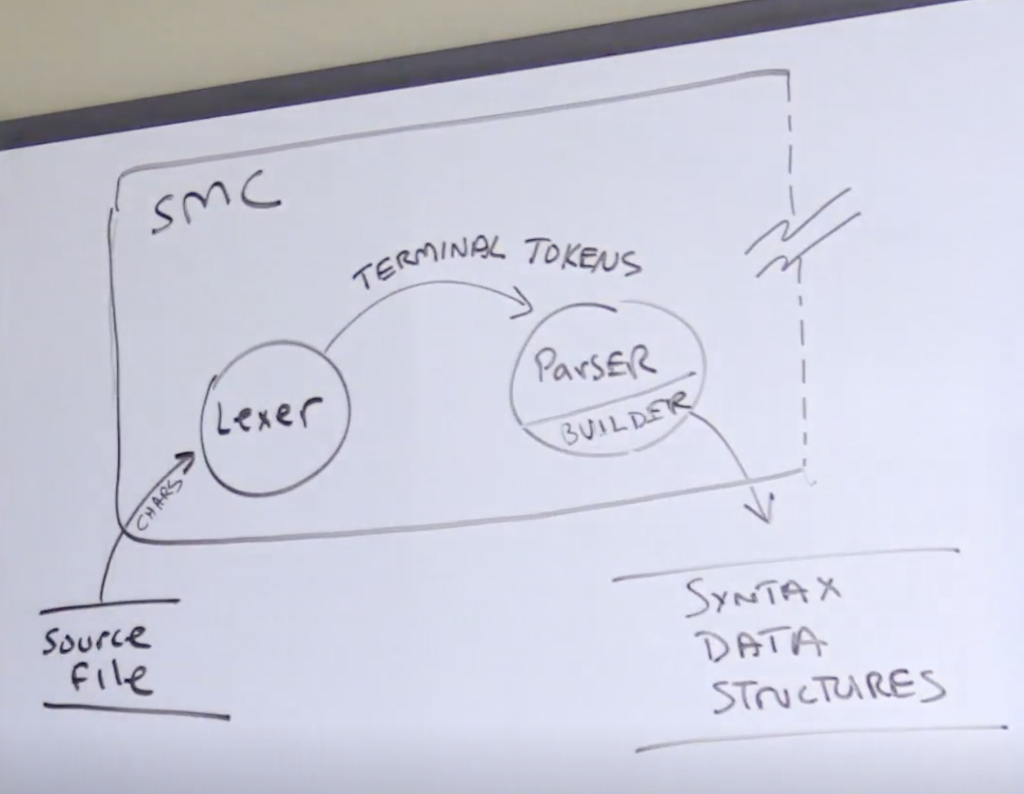
Lexical Analysis – Parsing our structure
Any system that can be represented in BNF can be parsed with a finite state machine
you can implement a parser by implementing the right finite state machine
Create the Lexer and then parse the structure string to create the data structures
The Data structures don’t know anything about the Lexer or the Parser

Slide 6
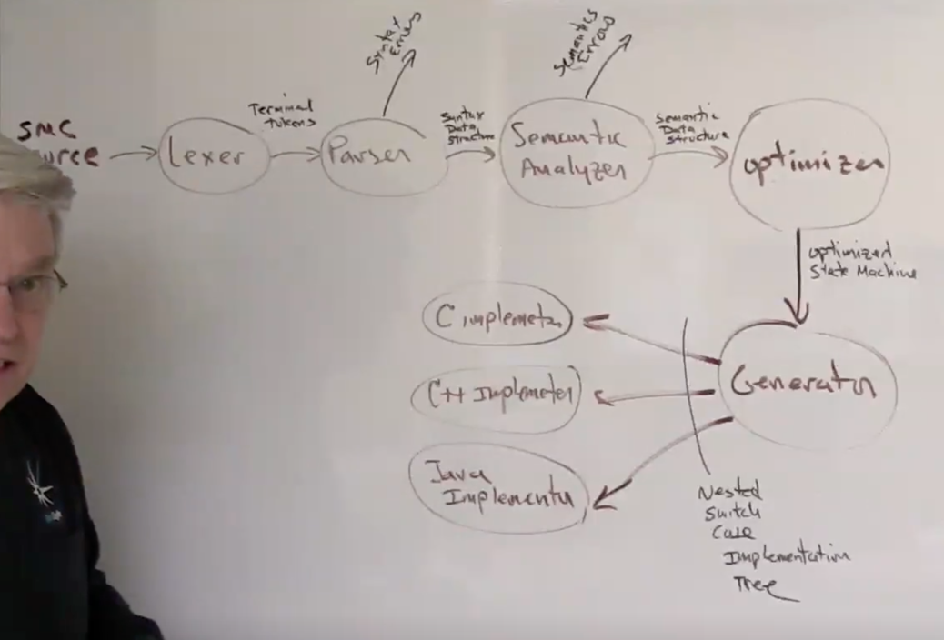
Generate the code
Lexer - Breaks the original string into Terminal Tokens described by our BNF
Parser – Consumes the tokens from the lexer and creates a syntax data structure assuming there are no errors
Semantic Analyser – Examines the syntax data structure to make sure the fsm makes sense.
Optimiser– Consumes syntax data structure and optimizes this into a simple state machine (I just converted it to an converter for simplicity)
Generator – Assembles a list of abstract nodes that represents the nested switch case statement to be generated.
Use the NSCNode interface to generate a Nested Switch Case Node which is independent of the language required. Use the Visitor Pattern

Slide 7
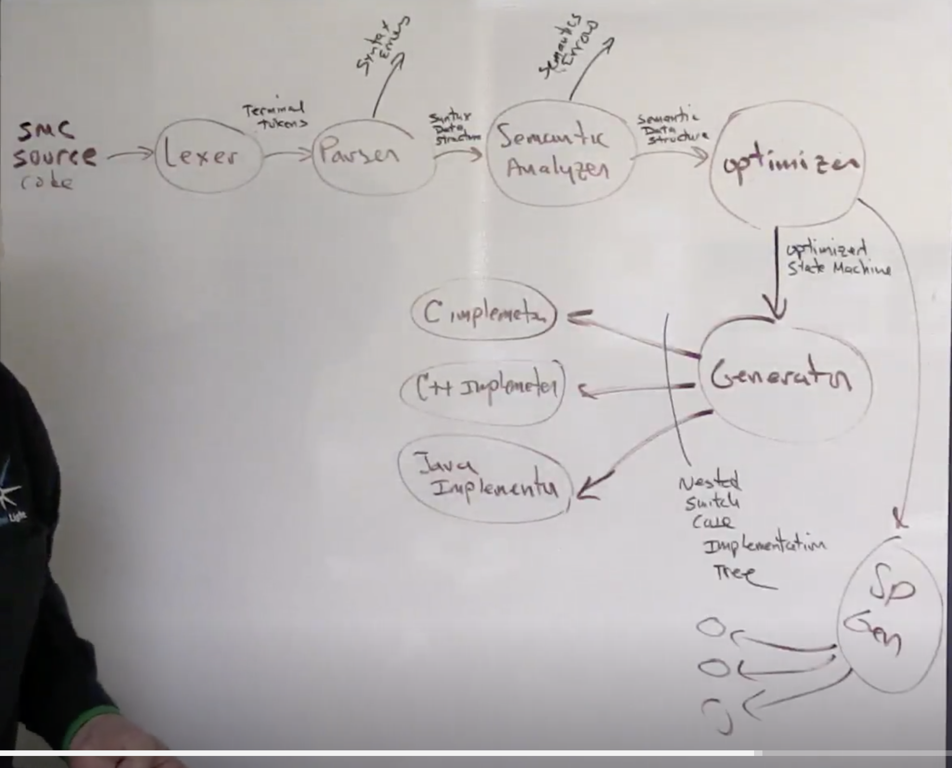
Modify the generator from Switch-Case to State Pattern
The generate code that uses the state pattern you would just need to add another generator, everything else would stay the same.
We stick with the nested switch case code generator though – as we don’t have to see the code, it is generated for us

